Slide 1
Skeletal System

Slide 2
The skeletal system is composed of 206 bones.
The skeletal system provides 1.) protection 2.)support 3.) production of red blood cells 4.) movement 5.) Triglyceride Storage (yellow fat) 6.) Storing Minerals
Bones are attached to other bones by ligaments.

Slide 3
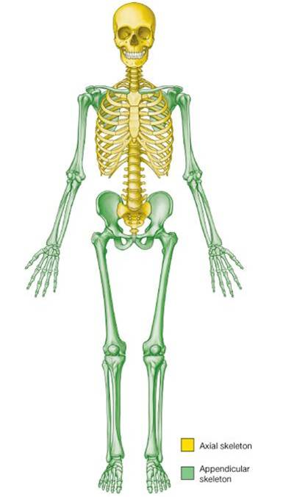
Axial Skeleton
Skull, Vertebral Column, Ribs, & Sternum
80 bones

Slide 4
Skull
Skull 29 bones
Cranium 8
Occipital 1
Temporal 2
Frontal 1
Parietal 2
  Sphenoid 2 Butterfly shaped or winged shaped

Slide 5
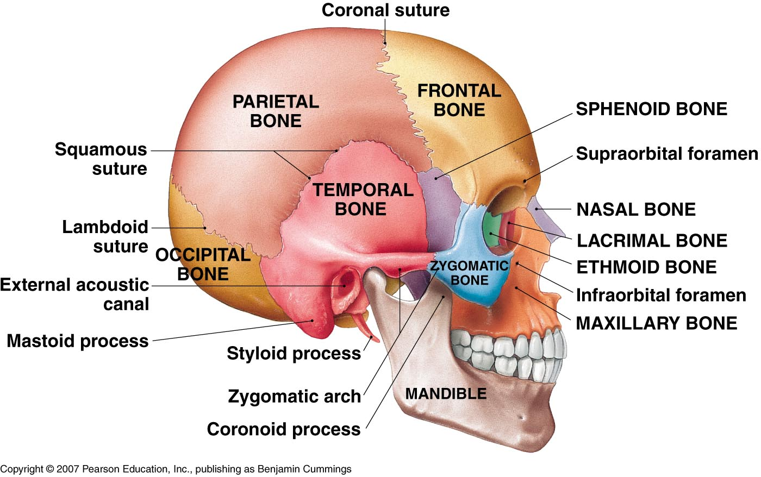

Slide 6
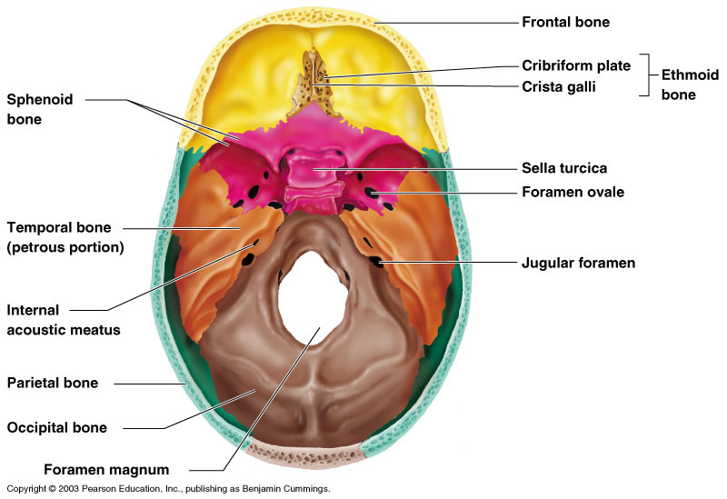

Slide 7
Face 14
Mandible 1
Maxillae 2
Zygomatic 2
  Lacrimal 2
  Ethmoid 2

Slide 8
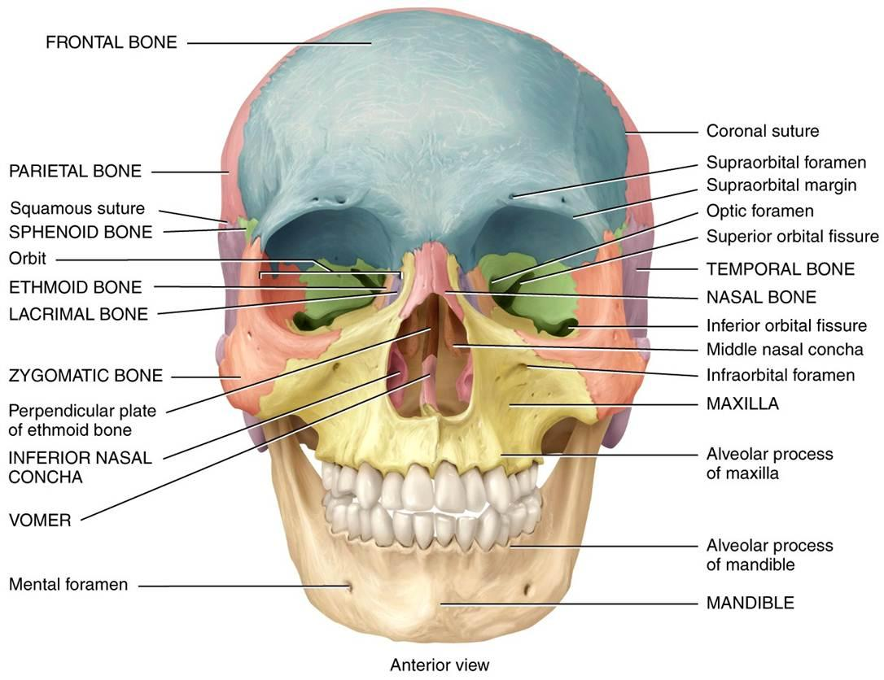

Slide 9
Vertebral column
26 bones
Vertebral column 26 bones
24 vertebrae & 1 sacrum & 1 coccyx
7 Cervical Vertebrae
Atlas 1st cervical vertebrae (nod yes)
Axis 2nd cervical vertebrae ( no )

Slide 10
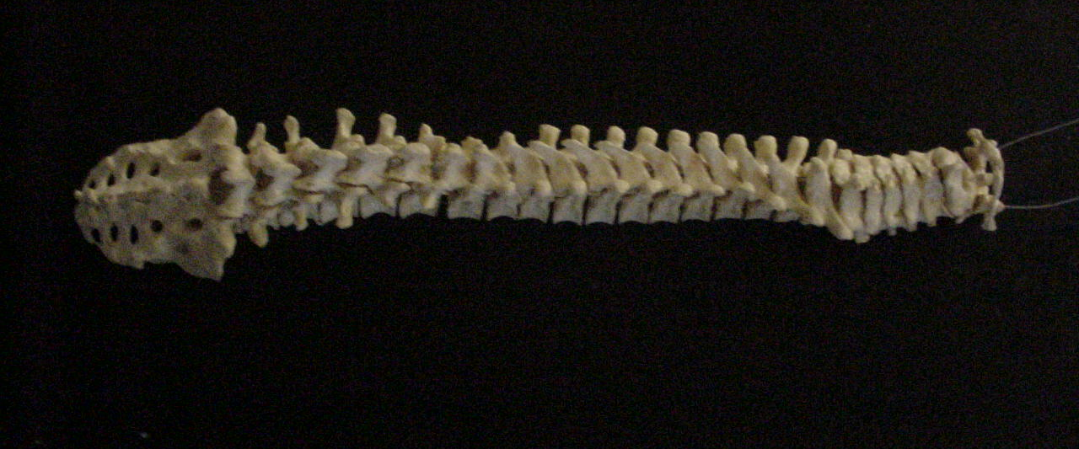
Vertebral Column
Sacrum (5) Coccyx (4)
Cervical Vertebrae (7)
Thoracic Vertebrae (12)
Lumbar Vertebrae (5)

Slide 11
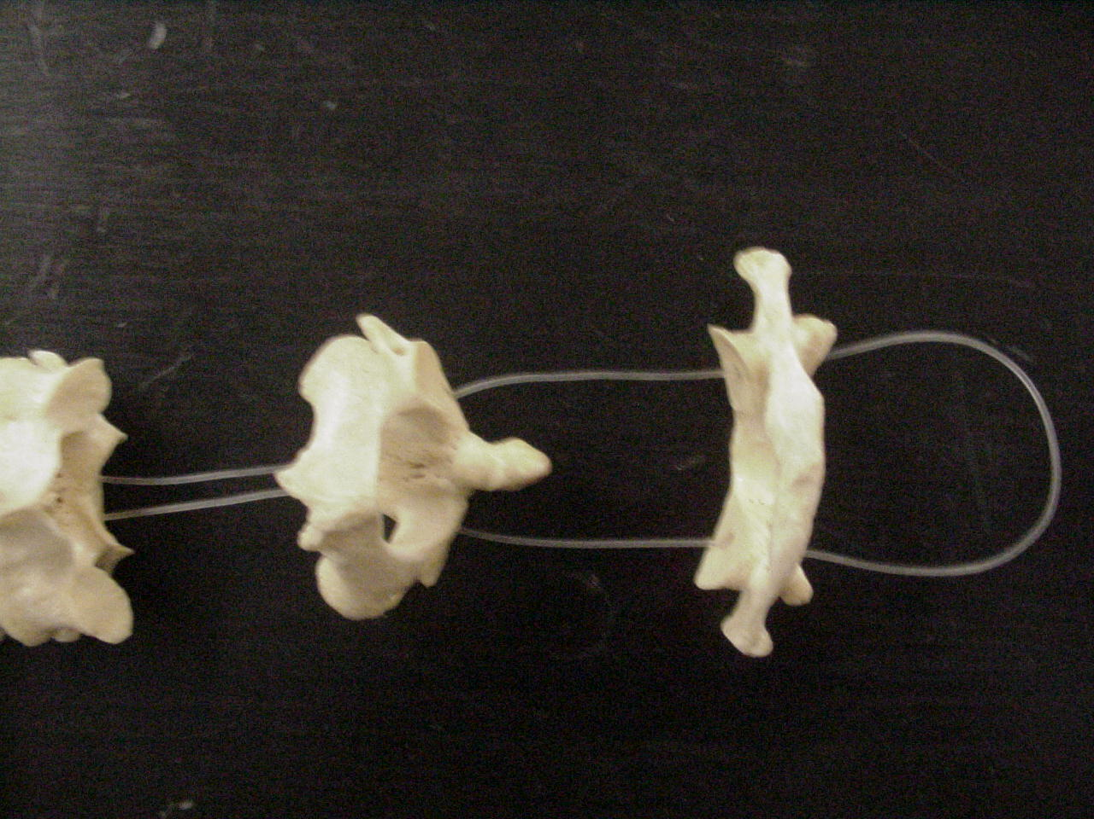
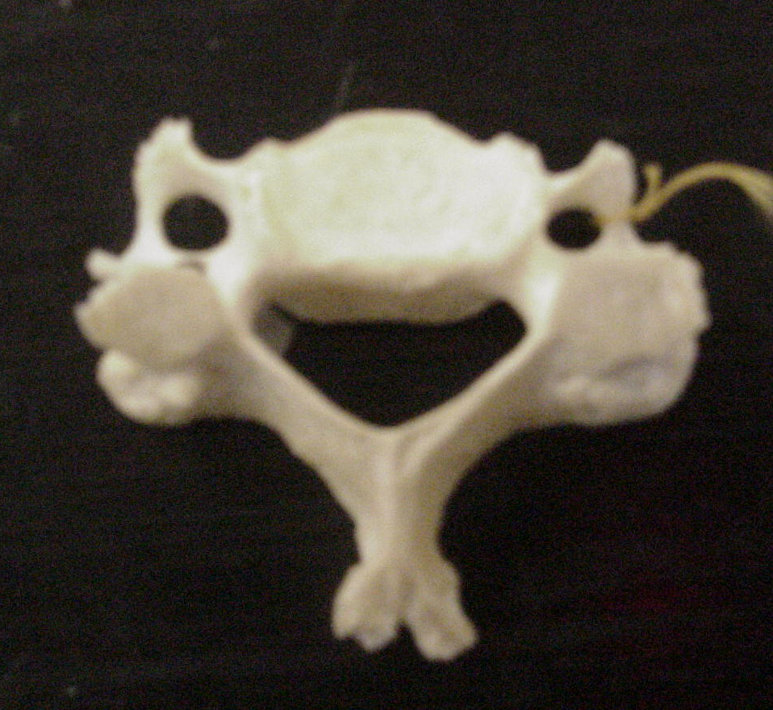
Cervical Vertebrae C1 & C2
Axis
Dens
Atlas
Body
Transverse Foramen
Vertebral Foramen
Spinous Process

Slide 12
12 Thoracic Vertebrae
5 Lumbar Vertebrae
Hyoid Sternum & ribs 26 bones

Slide 13
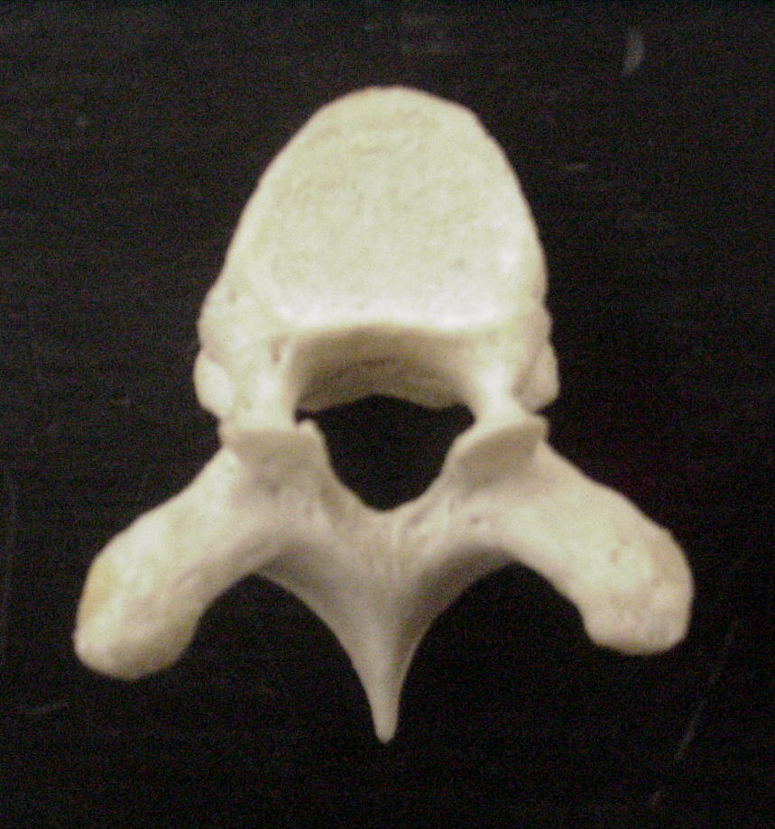
Thoracic Vertebra
Body
Superior Articular Process
Rib Facet
Transverse Process
Spinous Process

Slide 14
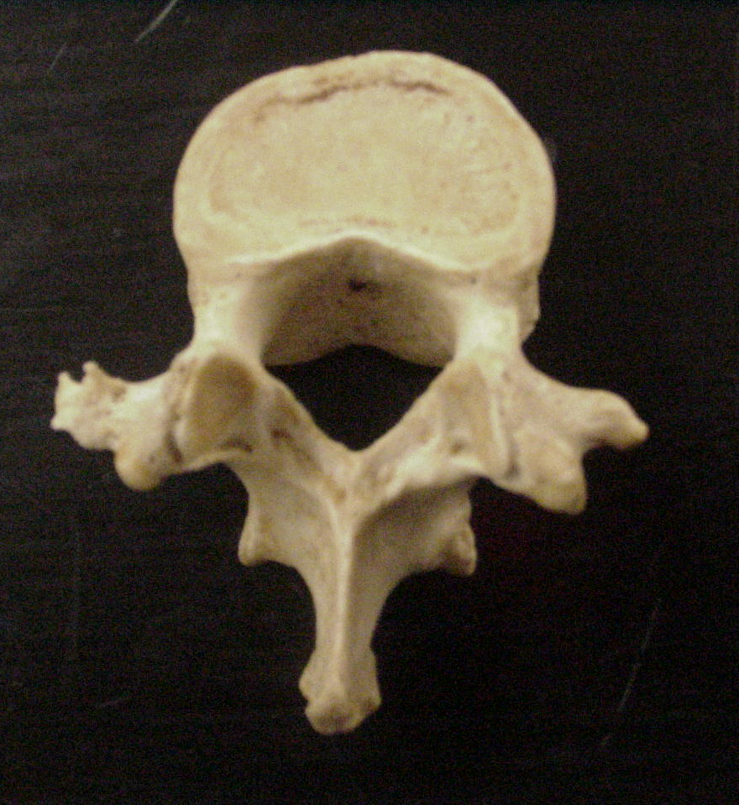
Lumbar Vertebra
Body
Transverse Process
Pedicle
Superior Articular Process
Spinous Process

Slide 15
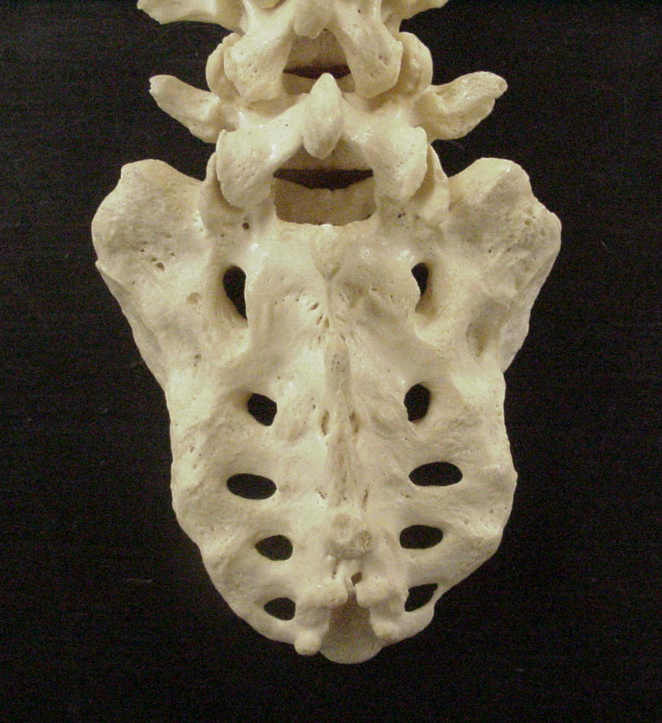
Sacrum
Ala
Sacral Canal
Median Sacral Crest
Posterior Sacral Foramen
Lateral Sacral Crest

Slide 16
Ribs
Composed of 12 pairs (24 bones) and the Sternum
The ribs are shaped like crescents, with one end flattened and the other end rounded. The rounded ends are attached at joints to the thoracic vertebrae at the back and the flattened ends come together at the sternum, in the front.
The upper seven pairs of ribs attach to the sternum with costal cartilage and are known as “true ribs.

Slide 17
Ribs
The 8th through 10th ribs have non-costal cartilage which connects them to the ribs above. The last two ribs are called “free ribs” because they do not attach to the sternum or to other ribs and simply “hang free.” The length of each rib increases from number one to seven and then decreases until rib pair number 12. The first rib is the shortest, broadest, flattest, and most curved.

Slide 18
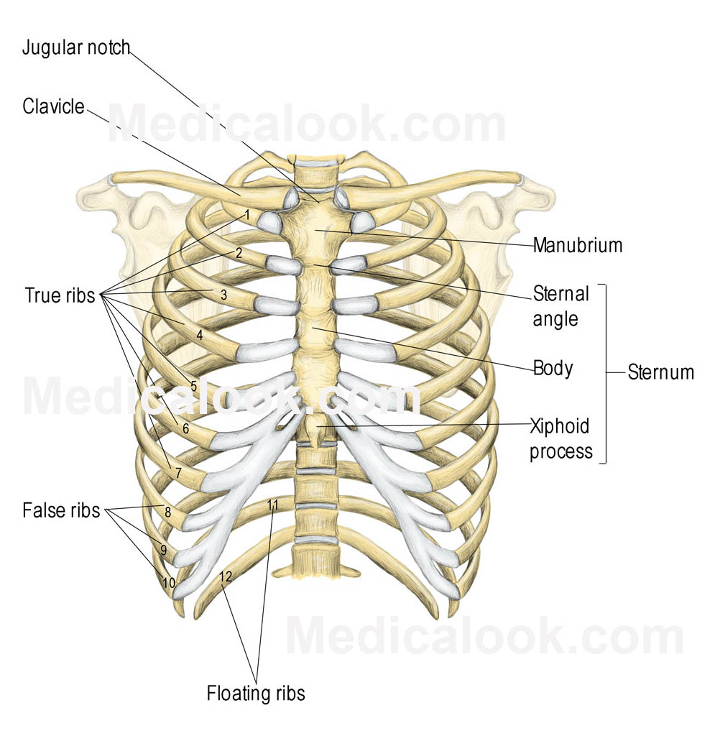

Slide 19
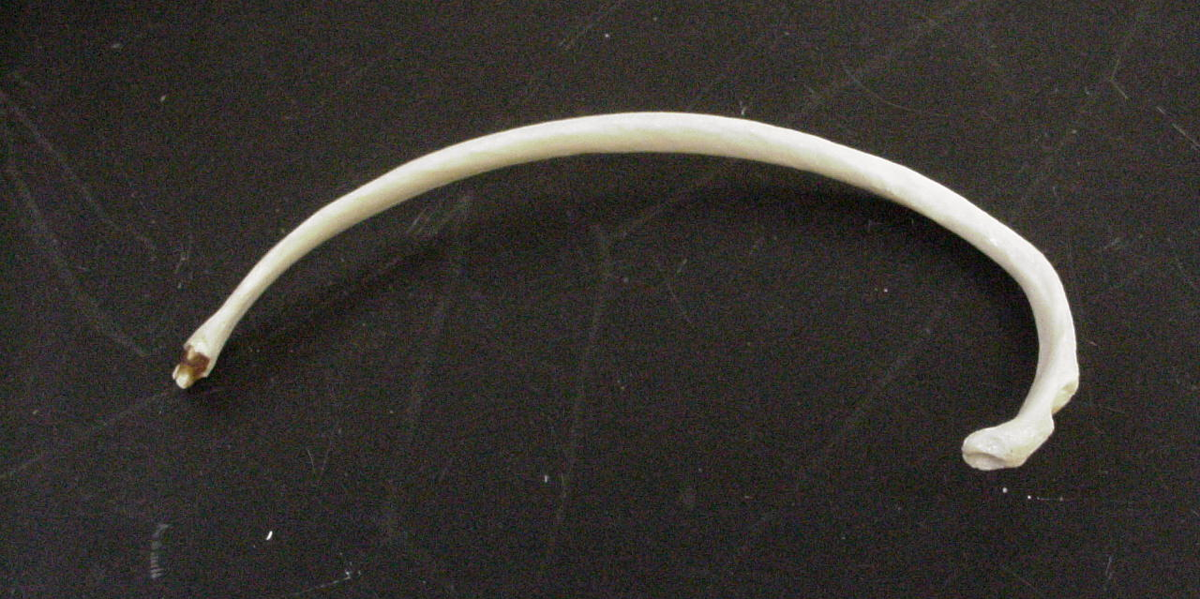
Rib
Sternal End
Angle
Tubercle
Neck
Head

Slide 20
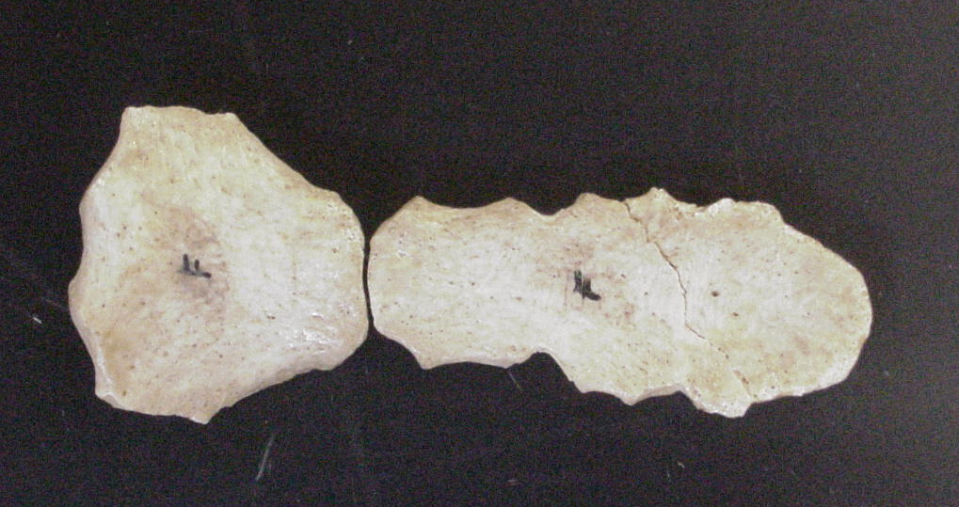
Sternum
Angle
Manubrium
Clavicular Notch
Body
Sternal Notch
What is missing?
Xiphoid Process

Slide 21
Appendicular Skeleton 126 bones
Pectoral Girdle & upper extremities 64 bones
Clavicle 2
Scapula 2
Humerus 2
Radius 2
  Ulna 2
Carpals 16
Metacarpals 10
Phalanges 28

Slide 22
Lower Extremities 62 bones
Coxal Bones 3
  Ilium, ischium and pubis
Femur 2
Tibia 2
Fibula 2
Tarsals 14

Slide 23
Terminology:
Articulating Surface: These are the areas of the bone that move in conjunction with another bone.
Condyle: Rounded projection for articulation with another bone.
Head: A portion of the bone that expands beyond its constricted neck.

Slide 24
Non-articulating Surfaces: Serve as attachment sights
Projections
1. Tuberosity : a large roughened projection
2. Tubercle: a small rounded projection
3. Spine: a sharp projection
4. Crest: a ridge
5. Process: an obvious portion that protrudes from a surface.
6. Trochanter: a prominent process.

Slide 25
Depressions
1. Fossa Shallow or hollow bone depression
2. Groove: long shallow depression
3.Foramen: a hole
4. Sinus: an air filled cavity
5. Meatus: a tube shaped opening

Slide 26
Bone Structure:
Diaphysis: The shaft of a long bone.
Epiphysis: Two enlarge ends of the bones
Proximal Epiphysis and Distal Epiphysis
Proximal Epiphysis contains the red bone marrow in adult bones.

Slide 27
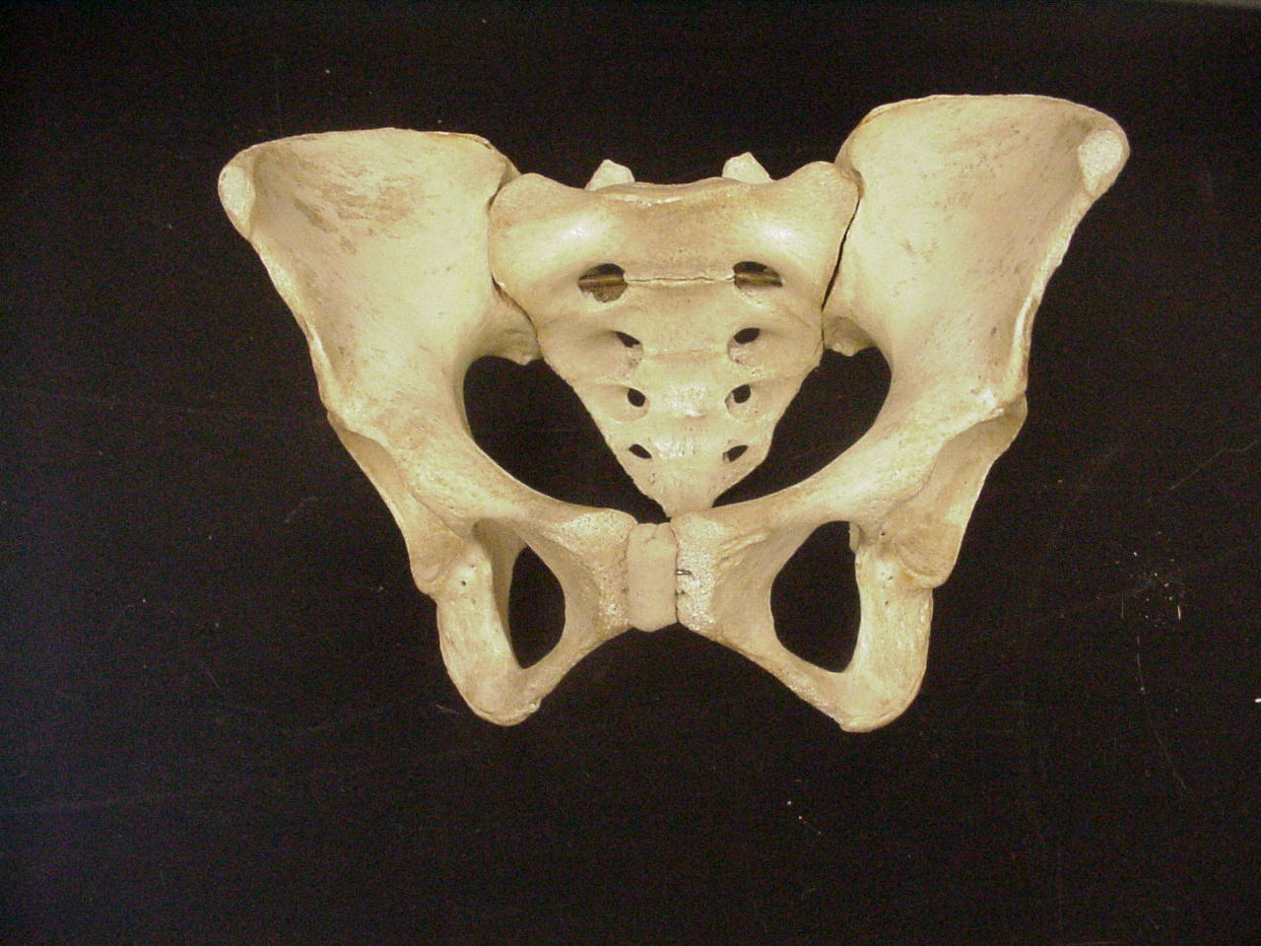
Pelvic Girdle

Slide 28
Pelvic girdle
Ilium: The larger, superior Portion of the pelvic region. ( Hip bone)
Iliac Crest: Rim of the ilium or hip.
Iliac fossa the depression of the ilium.
Ilium is fused to the Sacrum by the sacroiliac joint.

Slide 29
Ischium: The inferior and posterior portion of the hip.
Pubis: The inferior and anterior portion of the
Subpubic angle: male is more straight thanfemal skeloton.
Obturator Foramen: filled with connective tissue.
Symphysis pubis: joins the right and left halves.
Acetabulum: piont of articulation of the lower limb and the pelvic girdle.

Slide 30
Sacrum
Ilium
Iliac Fossa
Pelvic Brim
Acetabulum
Obturator Foraman
Ischium
Pubis
Pubic Symphasis
Pelvis

Slide 31
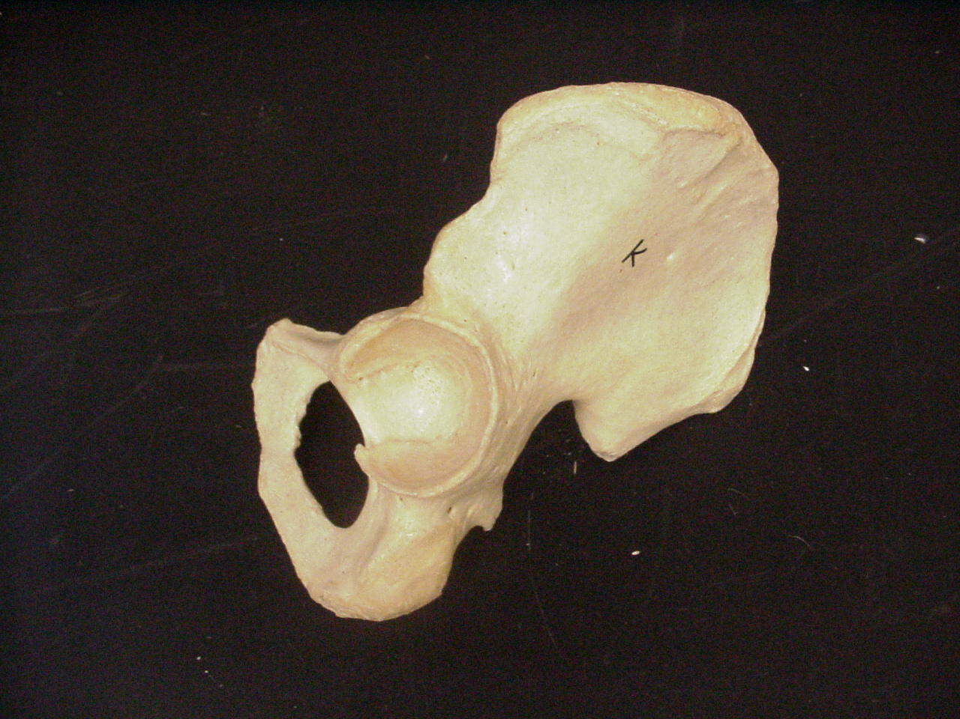
Iliac Crest
Coxal Bone
Posterior Superior Iliac Spine
Anterior Superior Iliac Spine
Anterior Inferior Iliac Spine
Posterior Inferior Iliac Spine
Acetabulum
Greater Sciatic Notch
Obturator Foramen
Ischial Tuberosity
Ischial Spine

Slide 32
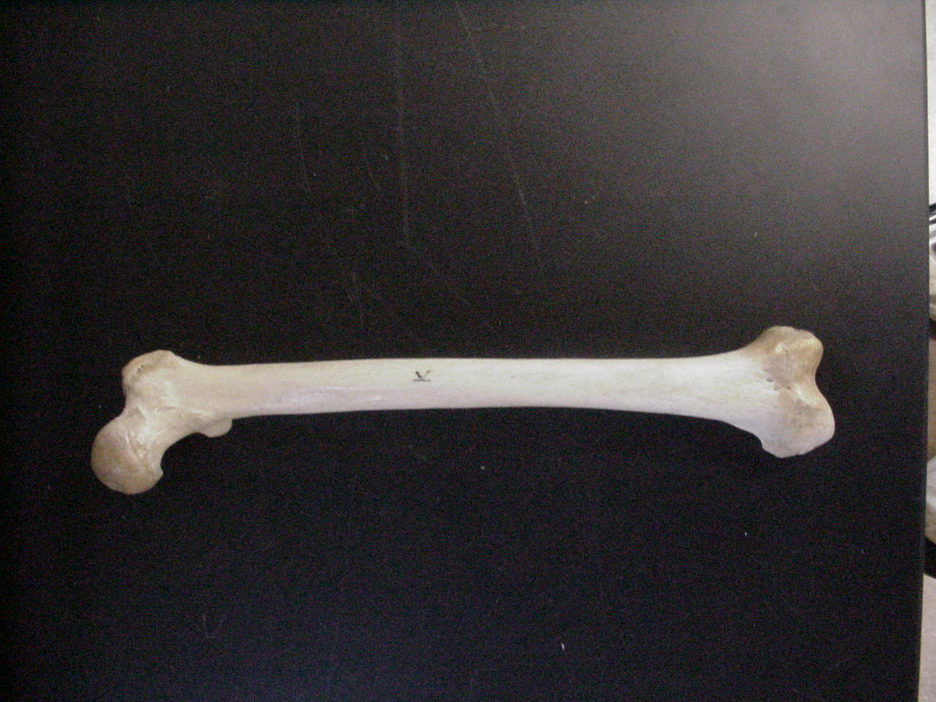
Femur
Greater Trochanter
Lateral Epicondyle
Head
Lesser Trochanter
Medial Epicondyle

Slide 33
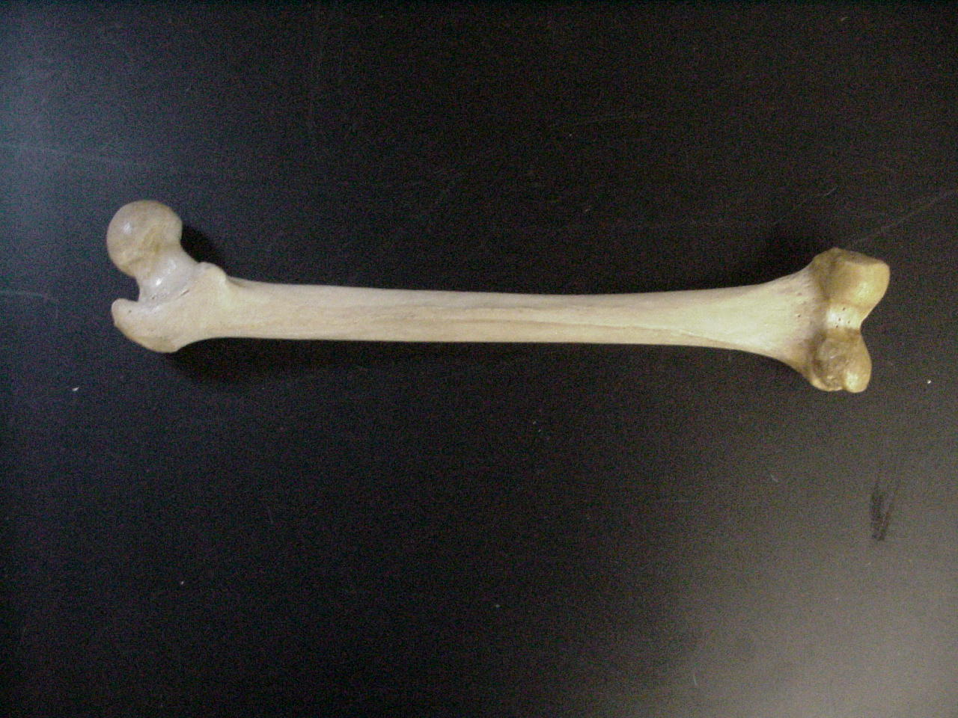
Femur posterior
Lesser Trochanter
Gluteal Tuberosity
Medial Epicondyle
Linea Aspera
Medial Condyle
Head
Lateral Condyle
Greater Trochanter
Lateral Epicondyle

Slide 34
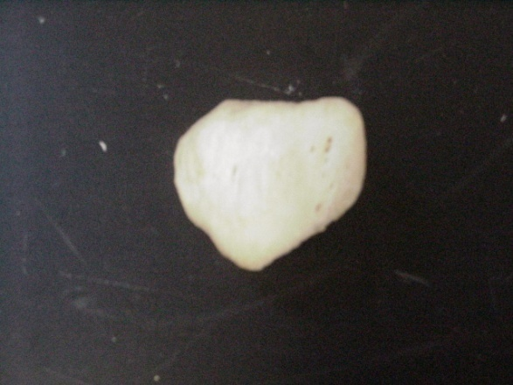
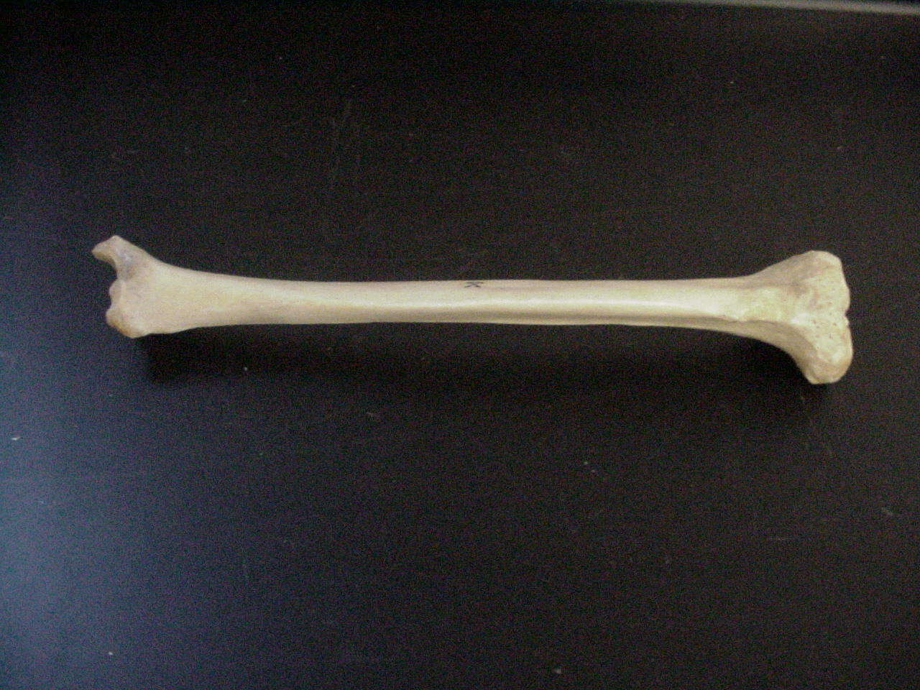
Tibia
Medial Malleolus
Anterior Tibial Crest
Tibial Tuberosity
Patella
Medial Condyle
Lateral Condyle

Slide 35
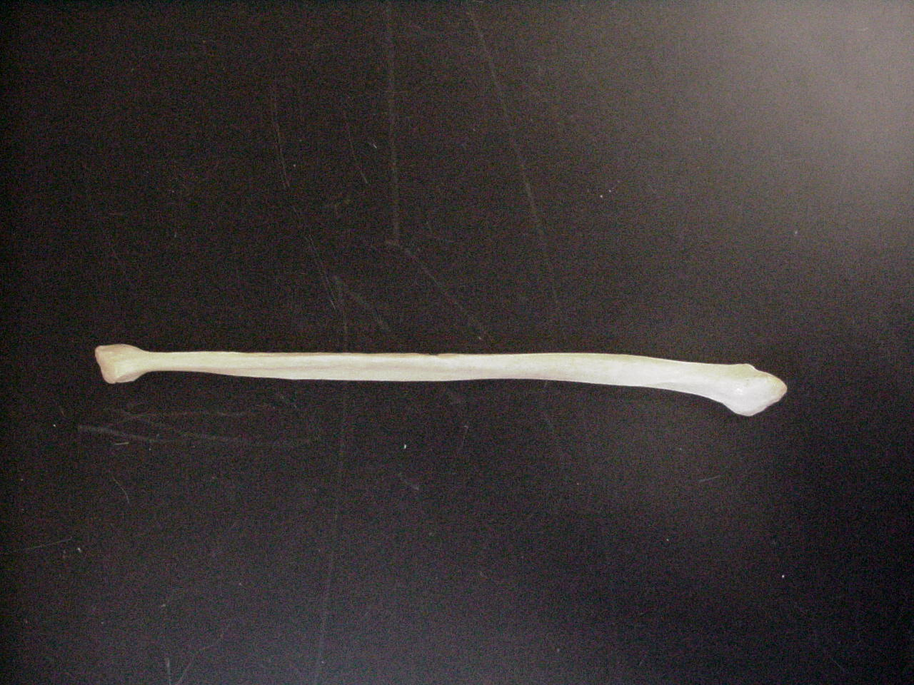
Fibula
Lateral Malleolus
Head

Slide 36
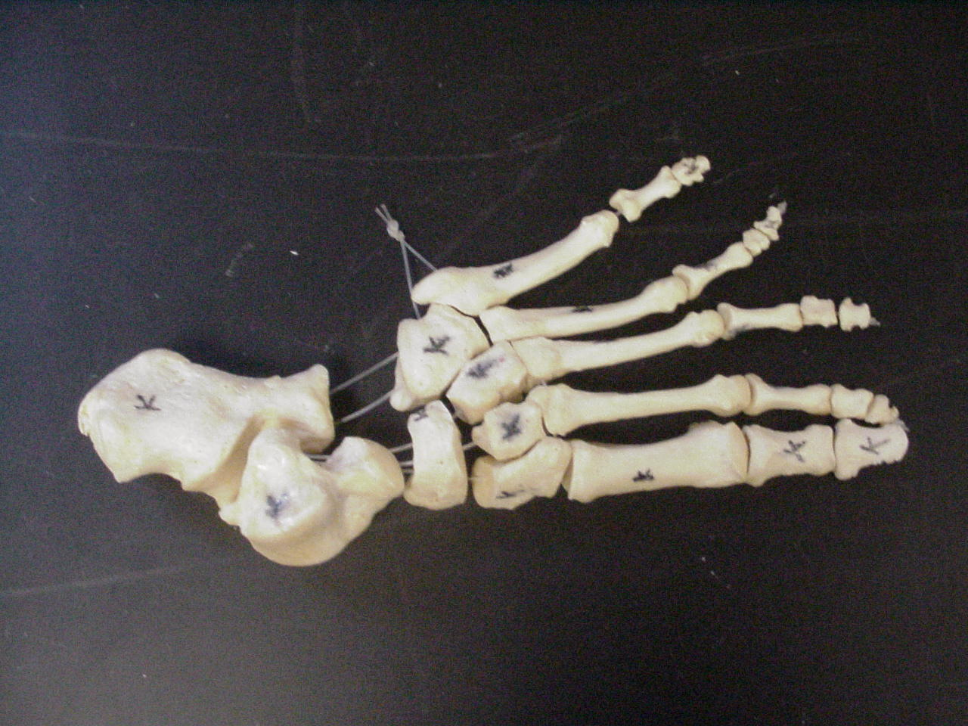
Proximal Phalanx
Middle Phalanx
5
4
Distal Phalanx
3
2
1
Proximal Phalanx
Tarsals
Metatarsals
Phalanges
Foot

Slide 37
Cuboid
Calcaneous
Talus
1st Cuneiform
Navicular
3rd Cuneiform
2nd Cuneiform
Foot - Tarsals

Slide 38
Bones Of the Upper Extremities.
Humerus
Scapula
Clavicle
Radius
Ulnu
Carples
Metacarples
Phalangees.

Slide 39
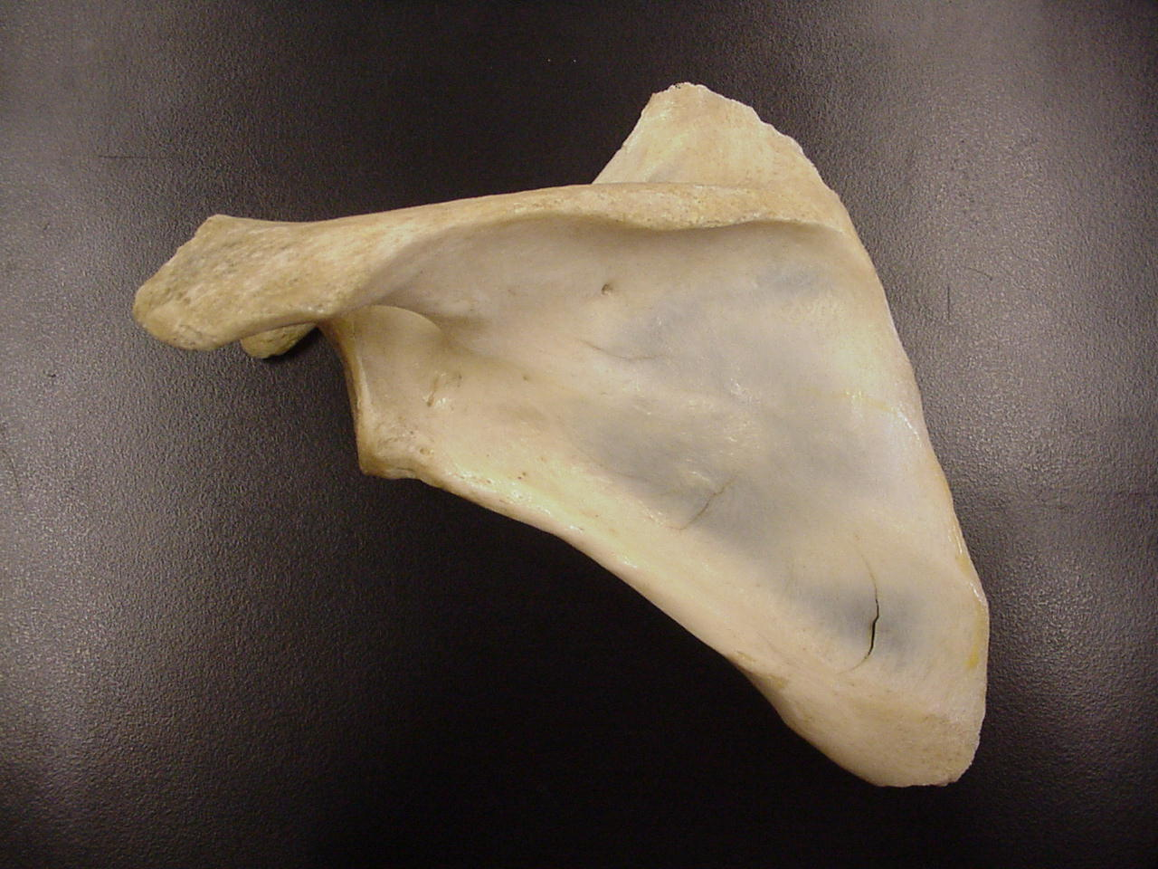
Posterior Scapula
Supraspinous Fossa
Scapula
Scapular Spine
Acromion
Infraspinous Fossa

Slide 40
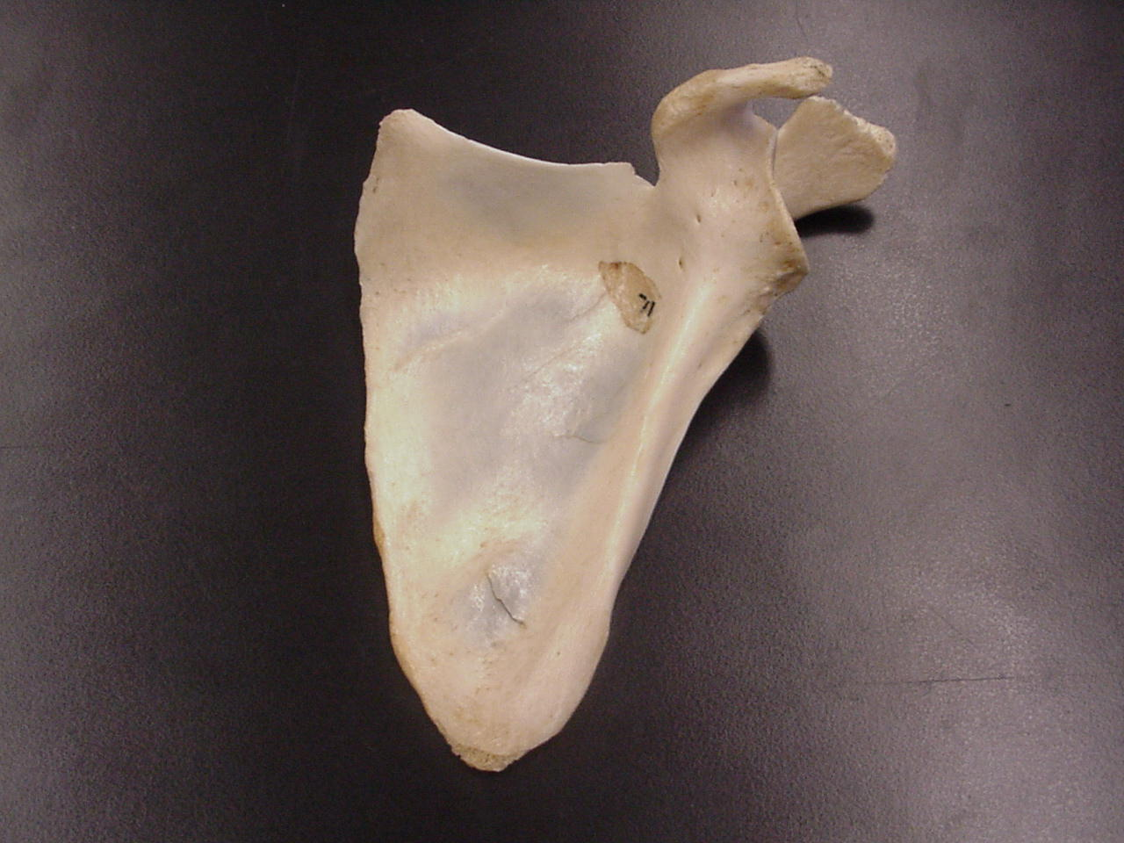
Anterior Scapula
Coracoid Process
Glenoid Cavity
Subscapular Fossa

Slide 41
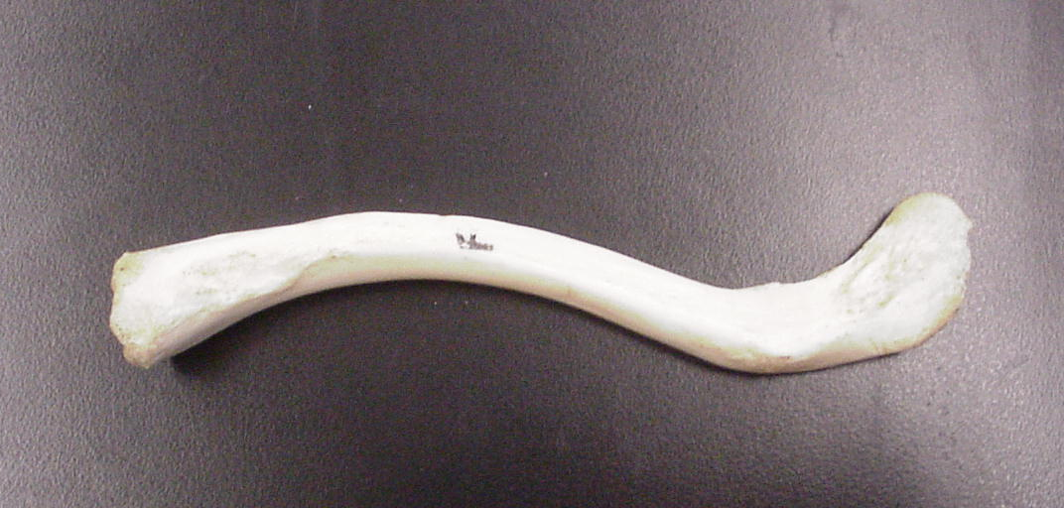
Clavicle (inferior view)
Sternal End
Acromial End
Conoid Tubercle

Slide 42
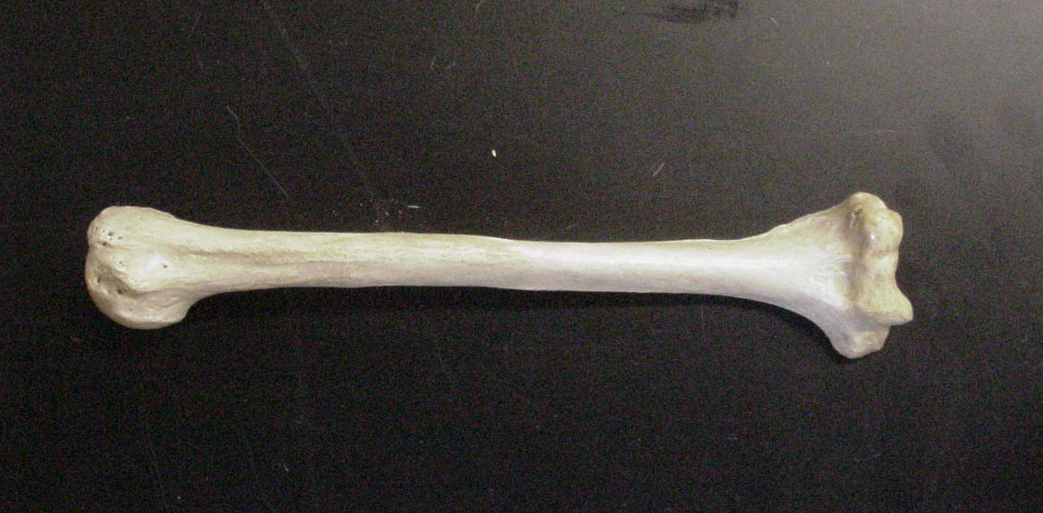
Humerus – Anterior View
Intertubercular Groove
Lateral Epicondyle
Greater Tubercle
Capitulum
Coronoid Fossa
Trochlea
Medial Epicondyle
Lesser Tubercle
Deltoid Tuberosity

Slide 43
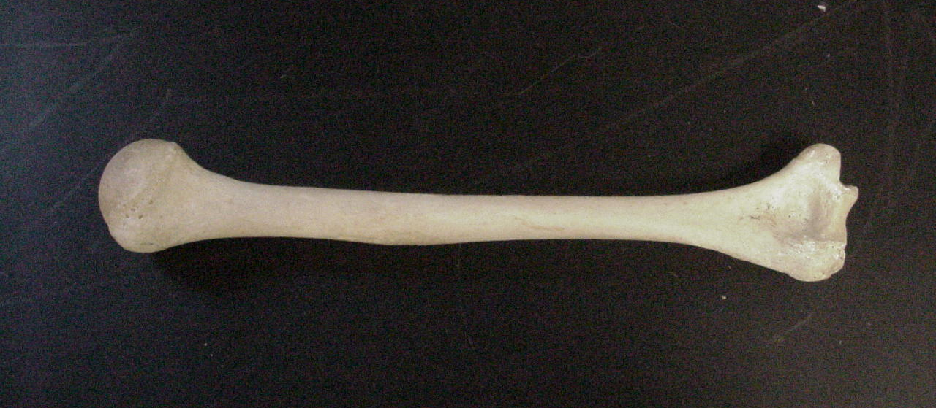
Humerus – Posterior View
Head
Olecranon Fossa
Greater Tubercle
Medial Epicondyle
Trochlea
Lateral Epicondyle

Slide 44
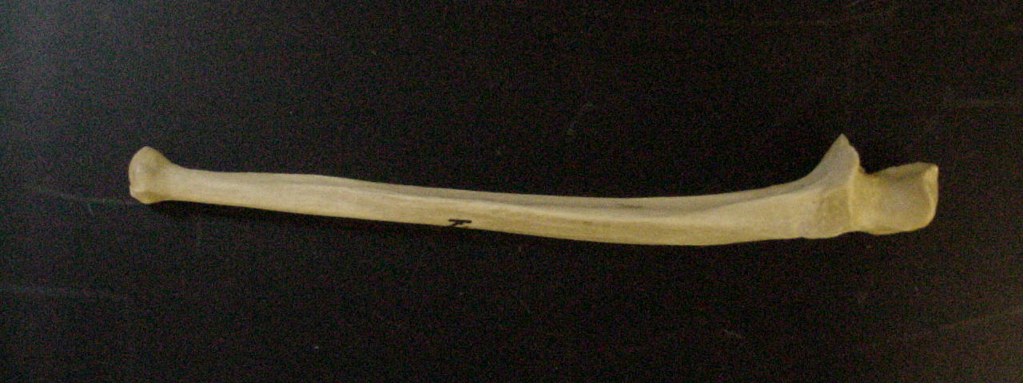
Ulna
Coronoid Process
Olecranon Process
Trochlear Notch
Styloid Process
Radial Notch
Head

Slide 45
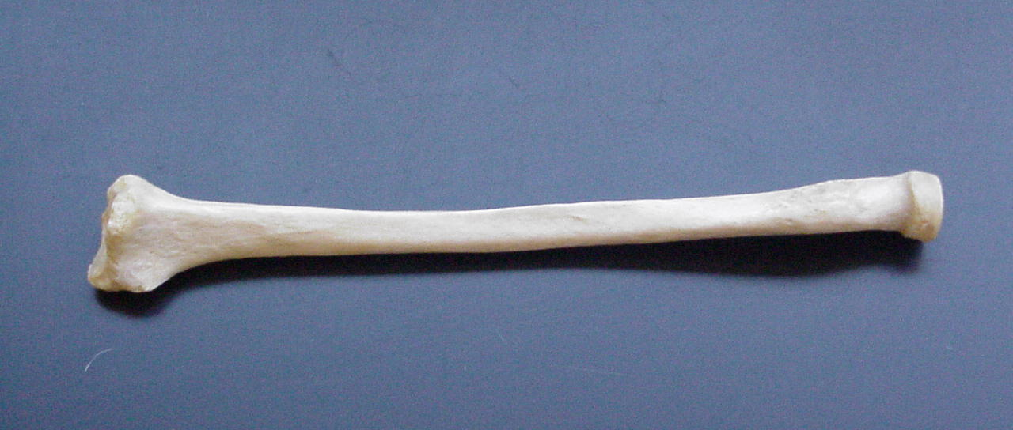
Radius
Radial Tuberosity
Head
Styloid Process

Slide 46
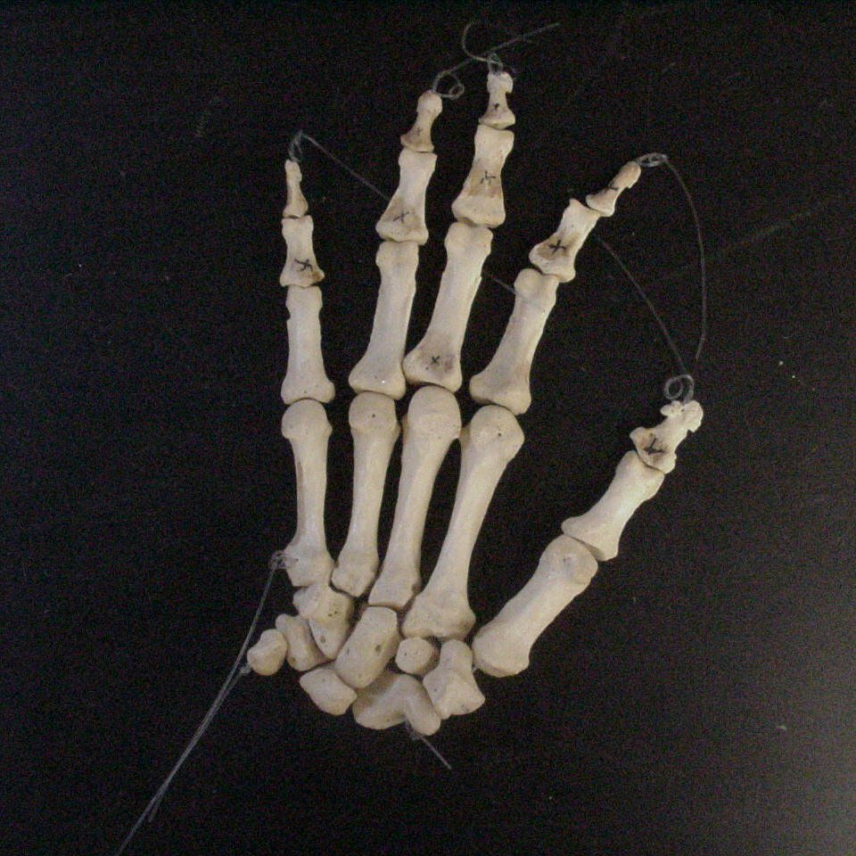
Hand and Wrist
Middle Phalanx
Distal Phalanx
Proximal Phalanx
Phalanges
Distal Phalanx
Metacarpals
5
3
4
2
1
Carpals
Proximal Phalanx

Slide 47
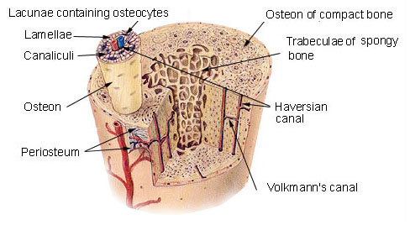
Bone Structure
Bones are organs. Thus, they’re composed of multiple tissue types. Bones are composed of:
  Bone tissue (a.k.a. osseous tissue).
  Fibrous connective tissue.
  Cartilage.
  Vascular tissue.
  Lymphatic tissue.
  Adipose tissue.
  Nervous tissue.

Slide 48
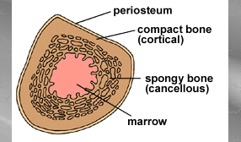
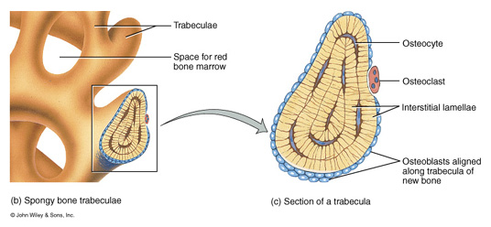
All bones consist of a dense, solid outer layer known as compact bone and an inner layer of spongy bone – a honeycomb of flat, needle-like projections called trabeculae.
Bone is an extremely dynamic tissue!!!!
Above: Note the relationship btwn the compact and spongy bone.
Below: Close up of spongy bone.

Slide 49
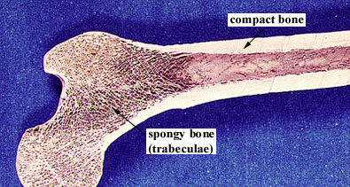
Note the gross differences between the spongy bone and the compact bone in the above photo.
Do you see the trabeculae?

Slide 50
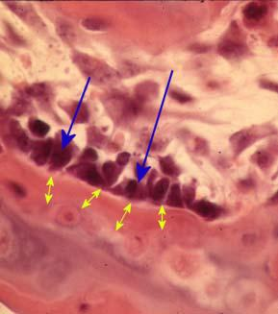
Bone Tissue
Bone tissue is a type of connective tissue, so it must consist of cells plus a significant amount of extracellular matrix.
Bone cells:
  Osteoblasts
    Bone-building cells.
    Synthesize and secrete collagen fibers and other organic components of bone matrix.
    Initiate the process of calcification.
    Found in both the periosteum and the endosteum
The blue arrows indicate the osteoblasts. The yellow arrows indicate the bone matrix they’ve just secreted.

Slide 51
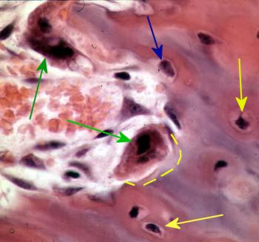
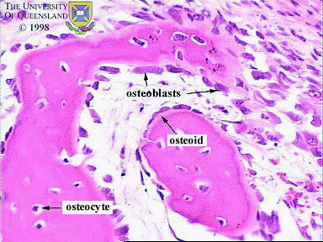
Bone Structure
Yellow arrows indicate osteocytes – notice how they are surrounded by the pinkish bone matrix.
Blue arrow shows an osteoblast in the process of becoming an osteocyte.
2. Osteocytes
    Mature bone cells.
    Osteoblasts that have become trapped by the secretion of matrix.
    No longer secrete matrix.
    Responsible for maintaining the bone tissue.
On the right, notice how the osteocyte is “trapped” within the pink matrix

Slide 52
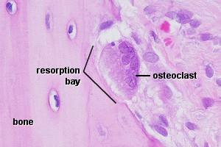
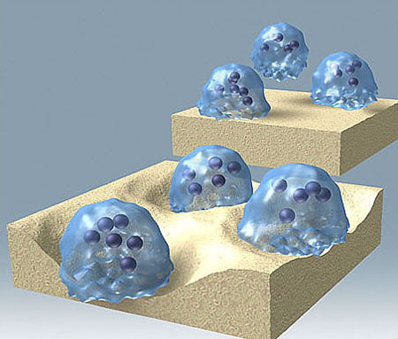
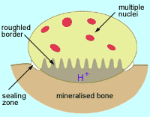
3. Osteoclasts
  Huge cells derived from the fusion of as many as 50 monocytes (a type of white blood cell).
  Cells that digest bone matrix – this process is called bone resorption and is part of normal bone growth, development, maintenance, and repair.
  Concentrated in the endosteum.
  On the side of the cell that faces the bone surface, the PM is deeply folded into a ruffled border. Here, the osteoclast secretes digestive enzymes (how might this occur?) to digest the bone matrix. It also pumps out hydrogen ions (how might this occur?) to create an acid environment that eats away at the matrix. What advantage might a ruffled border confer?
  Why do we want a cell that eats away at bone? (Hint: bone is a very dynamic tissue.)

Slide 53
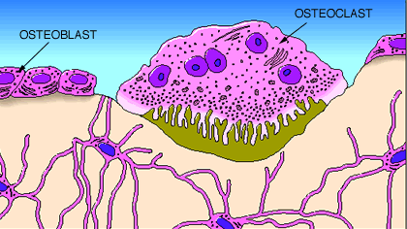
Here, we see a cartoon showing all 3 cell types. Osteoblasts and osteoclasts are indicated.
Note the size of the osteoclast (compare it to the osteoblast), and note the ruffled border.
Why is there a depression underneath the osteoclast?
What is the name of the third cell type shown here?
What do you think the tan material represents?

Slide 54
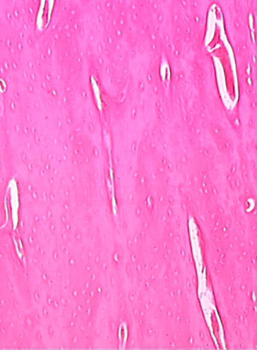
Bone Structure
Bone Matrix:
  Consists of organic and inorganic components.
  1/3 organic and 2/3 inorganic by weight.
    Organic component consists of several materials that are secreted by the osteoblasts:
      Collagen fibers and other organic materials
        These (particularly the collagen) provide the bone with resilience and the ability to resist stretching and twisting.

Slide 55


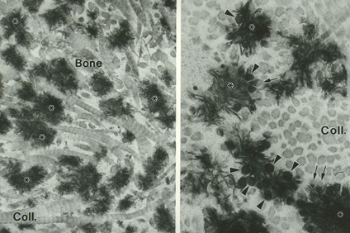
Three-dimensional array of collagen molecules. The rod-shaped molecules lie in a staggered arrangement which acts as a template for bone mineralization. Bone mineral is laid down in the gaps.
Inorganic component of bone matrix
  Consists mainly of 2 salts: calcium phosphate and calcium hydroxide. These 2 salts interact to form a compound called hydroxyapatite.
  Bone also contains smaller amounts of magnesium, fluoride, and sodium.
  These minerals give bone its characteristic hardness and the ability to resist compression.
Note collagen fibers in longitudinal & cross section and how they occupy space btwn the black bone cells.

Slide 56
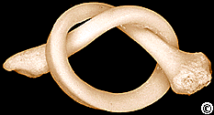
This bone:
a. Has been demineralized
b. Has had its organic component removed

Slide 57
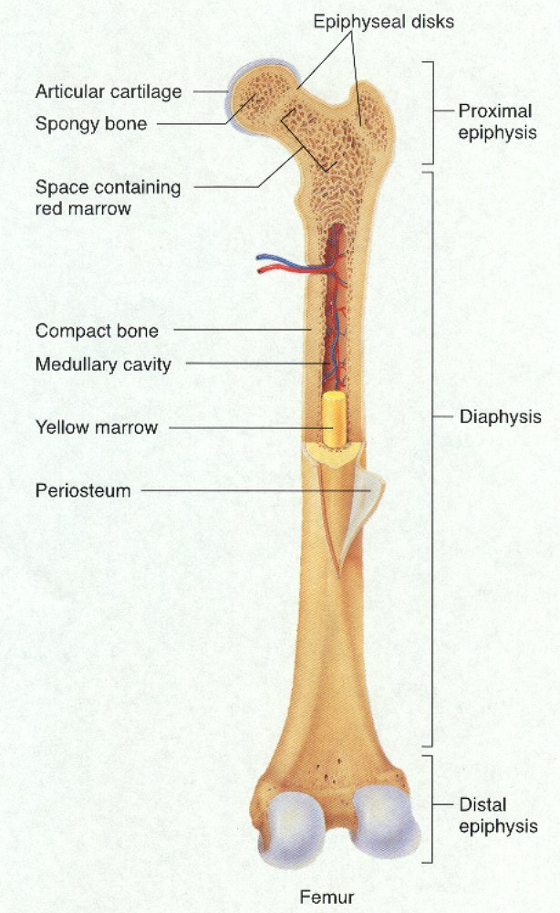
Long Bone Structure
Shaft plus 2 expanded ends.
Shaft is known as the diaphysis.
  Consists of a thick collar of compact bone surrounding a central marrow cavity
    In adults, the marrow cavity contains fat - yellow bone marrow.
Expanded ends are epiphyses
  Thin layer of compact bone covering an interior of spongy bone.
  Joint surface of each epiphysis is covered w/ a type of hyaline cartilage known as articular cartilage. It cushions the bone ends and reduces friction during movement.

Slide 58
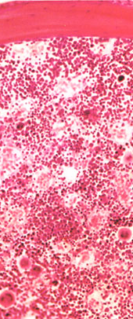
Bone Marrow
Bone marrow is a general term for the soft tissue occupying the medullary cavity of a long bone, the spaces amid the trabeculae of spongy bone, and the larger haversian canals.
There are 2 main types: red & yellow.
Red bone marrow = blood cell forming tissue = hematopoietic tissue
    Red bone marrow looks like blood but with a thicker consistency.
    It consists of a delicate mesh of reticular tissue saturated with immature red blood cells and scattered adipocytes.
Notice the red marrow and the compact bone

Slide 59
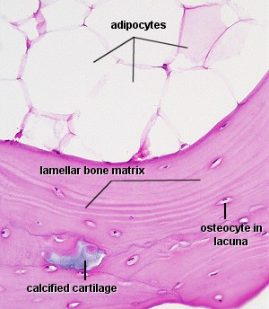
Distribution of Marrow
Note the compact bone on the bottom and marrow on the bottom.
In a child, the medullary cavity of nearly every bone is filled with red bone marrow.
In young to middle-aged adults, the shafts of the long bones are filled with fatty yellow bone marrow.
  Yellow marrow no longer produces blood, although in the event of severe or chronic anemia, it can transform back into red marrow
In adults, red marrow is limited to the axial skeleton, pectoral girdle, pelvic girdle, and proximal heads of the humerus and the femur.

Slide 60
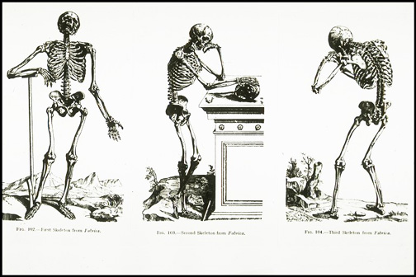
Bone Development
Osteogenesis (a.k.a. ossification) is the process of bone tissue formation.
In embryos this leads to the formation of the bony skeleton.
In children and young adults, ossification occurs as part of bone growth.
In adults, it occurs as part of bone remodeling and bone repair.

Slide 61
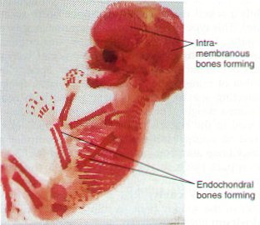
Formation of the Bony Skeleton
Before week 8, the human embryonic skeleton is made of fibrous membranes and hyaline cartilage.
After week 8, bone tissue begins to replace the fibrous membranes and hyaline cartilage.
  The development of bone from a fibrous membrane is called intramembranous ossification. Why?
  The replacement of hyaline cartilage with bone is known as endochondral ossification. Why?

Slide 62
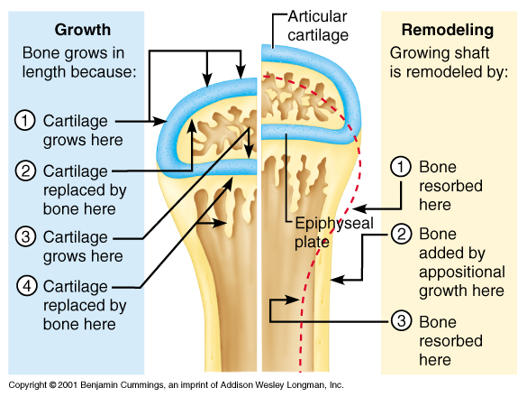
Growth in Bone Length
Epiphyseal cartilage (close to the epiphysis) of the epiphyseal plate divides to create more cartilage, while the diaphyseal cartilage (close to the diaphysis) of the epiphyseal plate is transformed into bone. This increases the length of the shaft.

Slide 63
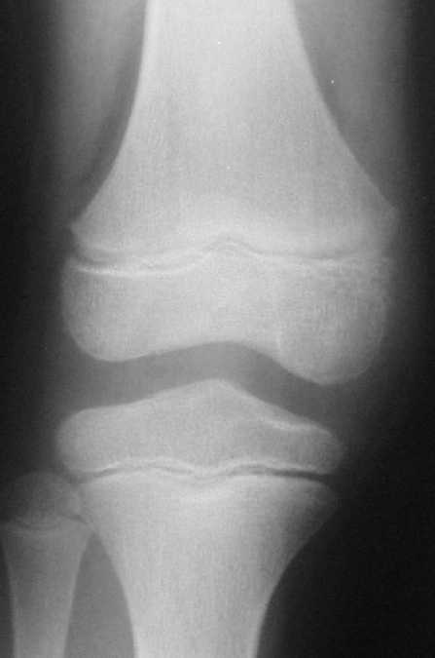
At puberty, growth in bone length is increased dramatically by the combined activities of growth hormone, thyroid hormone, and the sex hormones.
As a result osteoblasts begin producing bone faster than the rate of epiphyseal cartilage expansion. Thus the bone grows while the epiphyseal plate gets narrower and narrower and ultimately disappears. A remnant (epiphyseal line) is visible on X-rays (do you see them in the adjacent femur, tibia, and fibula?)

Slide 64
Growth in Bone Thickness
Osteoblasts beneath the periosteum secrete bone matrix on the external surface of the bone. This obviously makes the bone thicker.
At the same time, osteoclasts on the endosteum break down bone and thus widen the medullary cavity.
This results in an increase in shaft diameter even though the actual amount of bone in the shaft is relatively unchanged.

Slide 65

Fractures
Despite its mineral strength, bone may crack or even break if subjected to extreme loads, sudden impacts, or stresses from unusual directions.
  The damage produced constitutes a fracture.
The proper healing of a fracture depends on whether or not, the blood supply and cellular components of the periosteum and endosteum survive.

Slide 66
Fracture Types
Fractures are often classified according to the position of the bone ends after the break:
  Open (compound) ➔ bone ends penetrate the skin.
  Closed (simple) ➔ bone ends don’t penetrate the skin.
  Comminuted ➔ bone fragments into 3 or more pieces. Common in the elderly (brittle bones).
  Greenstick ➔ bone breaks incompletely. One side bent, one side broken. Common in children whose bone contains more collagen and are less mineralized.
  Spiral ➔ ragged break caused by excessive twisting forces. Sports injury/Injury of abuse.
  Impacted ➔ one bone fragment is driven into the medullary space or spongy bone of another.

Slide 67





Slide 68

Bone Remodeling
Bone is a dynamic tissue.
  What does that mean?
Wolff’s law holds that bone will grow or remodel in response to the forces or demands placed on it. Examine this with the bone on the left.

Slide 69
  Check out the mechanism of remodeling on the right!
  Why might you suspect someone whose been a powerlifter for 15 years to have heavy, massive bones, especially at the point of muscle insertion?
  Astronauts tend to experience bone atrophy after they’re in space for an extended period of time. Why?

Slide 70

Nutritional Effects on Bone
Normal bone growth/maintenance cannot occur w/o sufficient dietary intake of calcium and phosphate salts.
Calcium and phosphate are not absorbed in the intestine unless the hormone calcitriol is present. Calcitriol synthesis is dependent on the availability of the steroid cholecalciferol (a.k.a. Vitamin D) which may be synthesized in the skin or obtained from the diet.
Vitamins C, A, K, and B₁₂ are all necessary for bone growth as well.

Slide 71


Hormonal Effects on Bone
Growth hormone, produced by the pituitary gland, and thyroxine, produced by the thyroid gland, stimulate bone growth.
  GH stimulates protein synthesis and cell growth throughout the body.
  Thyroxine stimulates cell metabolism and increases the rate of osteoblast activity.
  In proper balance, these hormones maintain normal activity of the epiphyseal plate (what would you consider normal activity?) until roughly the time of puberty.

Slide 72


Hormonal Effects on Bone
At puberty, the rising levels of sex hormones (estrogens in females and androgens in males) cause osteoblasts to produce bone faster than the epiphyseal cartilage can divide. This causes the characteristic growth spurt as well as the ultimate closure of the epiphyseal plate.
Estrogens cause faster closure of the epiphyseal growth plate than do androgens.
Estrogen also acts to stimulate osteoblast activity.

Slide 73

Parathyroid Hormone
Released by the cells of the parathyroid gland in response to low blood [Ca²⁺].Causes blood [Ca²⁺] to increase.
PTH will bind to osteoblasts and this will cause 2 things to occur:
    The osteoblasts will decrease their activity and they will release a chemical known as osteoclast-stimulating factor.
    Osteoclast-stimulating factor will increase osteoclast activity.
PTH increases calcitriol synthesis which increases Ca²⁺ absorption in the small intestine.
PTH decreases urinary Ca²⁺ excretion and increases urinary phosphate excretion.

Slide 74
Decreased Blood [Ca²⁺]
Increased PTH release by parathyroid gland
Binds to osteoblast causing decreased osteoblast activity and release of osteoclast-stimulating factor
Increased calcitriol synthesis
Decreased Ca²⁺ excretion
Increased intestinal Ca²⁺ absorption
OSF causes increased osteoclast activity
Decreased bone deposition and increased bone resorption
Increased Blood [Ca²⁺]

Slide 75

Clinical Conditions
Osteomyelitis
  Osteo=bone + myelo=marrow + itis=inflammation.
  Inflammation of bone and bone marrow caused by pus-forming bacteria that enter the body via a wound (e.g., compound fracture) or migrate from a nearby infection.
  Fatal before the advent of antibiotics.

Slide 76


Clinical Conditions
Osteoporosis
  Group of diseases in which bone resorption occurs at a faster rate than bone deposition.
  Bone mass drops and bones become increasingly porous.
  Compression fractures of the vertebrae and fractures of the femur are common.
  Often seen in postmenopausal women because they experience a rapid decline in estrogen secretion; estrogen stimulates osteoblast and inhibits osteoclast activity.
    Based on the above, what preventative measures might you suggest?

Slide 77


Clinical Conditions
Gigantism
  Childhood hypersecretion of growth hormone by the pituitary gland causes excessive growth.
Acromegaly
  Adulthood hypersecretion of GH causes overgrowth of bony areas still responsive to GH such as the bones of the face, feet, and hands.
Pituitary dwarfism
  GH deficiency in children resulting in extremely short long bones and maximum stature of 4 feet.

